Slide 1
Team 2 ParkEz
UML Class and Sequence Diagrams for Iteration 3

Slide 2
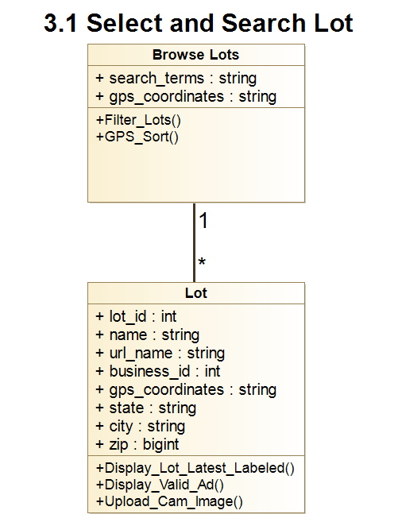

Slide 3

3.1 Select and Search Lot
:Car Parking User / Any user
:Browse Lots
:Lot
Use Case Scenario
This use case begins when Car Parking User selects “Browse Parking Lots” to view all the available ParkEz monitored lots.
Car parking users will select a lot after filtering and sorting as desired.
Public lot info is displayed for that lot.
Get_Lots
Display_Lot_Latest_Labeled
Sorted/filtered lot list
Public Lot Info

Slide 4
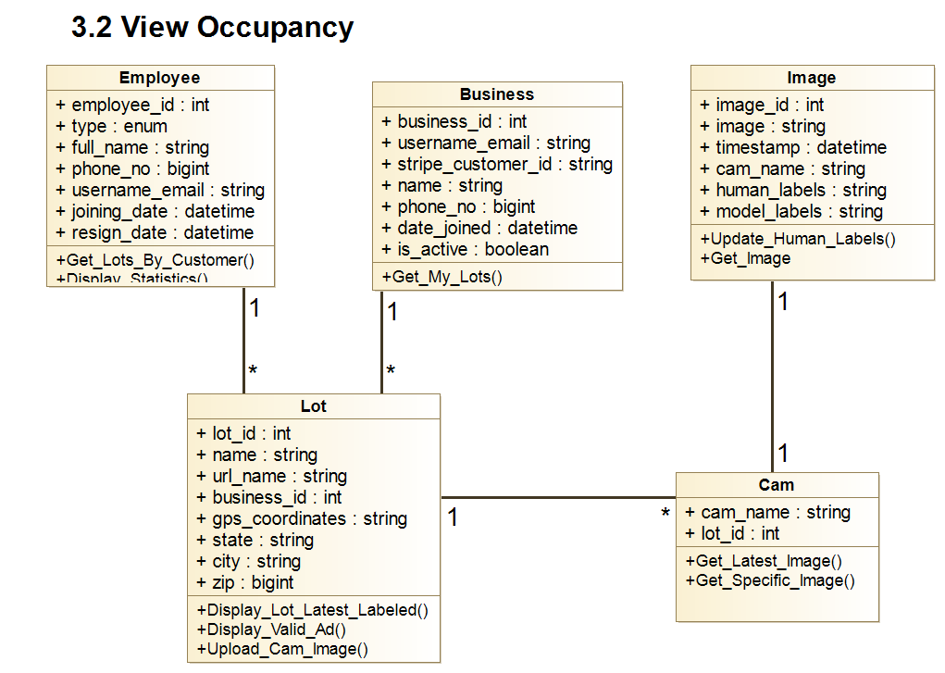

Slide 5
3.2 View Occupancy
:Lot Business User Lot Business Manager
Customer Support Manager
:Lot
:Cam
:Image
Use Case Scenario
Car parking user selects the desired parking lot.
The user sees available and used parking spots.
The algorithm selects the best parking spot out of the available spots
Display_Lot_Latest_Labeled
Get_Latest_Image
Get_Image
Lot Overview
Image and Labels
Image and Labels

Slide 6
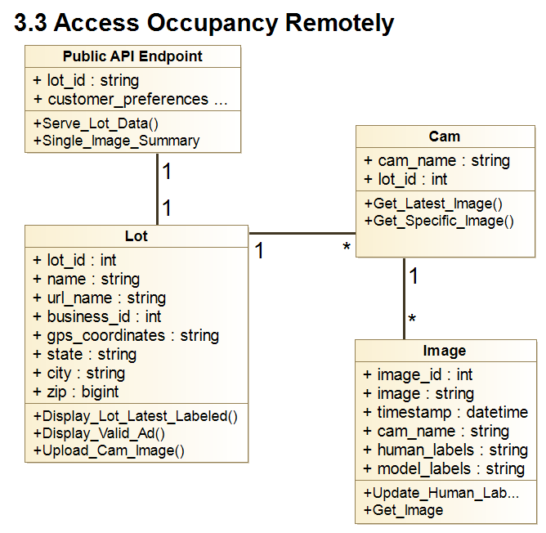

Slide 7
3.3 Access Occupancy Remotely
:Anonymous Actor / Car Parking User
:Lot
:Cam
:Image
Use Case Scenario
Car Parking User navigates to a business website with embedded ParkEz parking information.
The user views the current occupancy information, which includes the number of occupied and vacant spots.
The user views the webcam images that show the actual parking lot with indicators highlighting occupied and vacant spots.
The system also marks the recommended best spot based on current occupancy and distance to the business entrance.
The user makes a parking decision based on the information provided.
Display_Lot_Latest_Labeled
Get_Latest_Image
Get_Image
Lot Overview
Image and Labels
Image and Labels

